Slide 1
Overall– Research and Questions (SHOC-N list)
(Accelerate Innovation and Integration To Achieve System of Systems)
KRADOS Database Connections
Accelerate KRADOS X Backend Database: Ensure its designed/ built for future integrations/requirements; system of systems approach (Nexus, Kill Chain, MSS, etc)
TAPSOS – Build APIs with WIDOW and JMPS (Hooks) to be able to share Msn Data with KRADOS X; conduct concurrent operational and tactical planning
NEXUS – Early understanding of Nexus will allow us to plan for better systems integration; Palantir could expedite initiatives
Build APIs with MAVEN to meet 613th Kill Chain Execution, Accurate Operational Planning, and
FrOB Initiatives
Start C2IMERA connection to MAI TAI earlier
Software Innovation and Automation (enable better Operational/Tactical C2 of Blue Forces)
Data Lake / Lakehouse /
Joint FrOB Opportunity ?
Operational / Tactical Mission Planning
Expand WIDOW to meet Tactical Planning Gaps
JMPS and Widow integration
Utilize JMPS to push msn data information through UDL between operational and tactical echelons; Integrate JMPS into AOC – Planning and Execution
ATO/ACO Dissemination
Identify critical distribution notes (Data Integration Layers, Data Lakehouses/Lakes/Warehouses) for ATO/ACO Dissemination
Develop and demonstrate ability to push UDL (JMPS/JOMS, AMC, Space, etc) and Longbow.
Software Evaluation, Innovation, Development, and Integration
AROPS , ENVISION
FIGHT TONIGHT and ALCHEMY (DARPA)
Expand Tanker C2 Capabilities
Connect ATOMS to 613th AOC, Expand capabilities, and enable dynamic retargeting of tankers in Indo-Pacific Theater
AROPS
Support Kill Web Efforts (MCHMR) – Overlap w/ TAPSOS
Test
Integrate MAVEN with developmental MCHMR Mesh Network

Slide 2
Combat Plan – Research and Questions
(Accelerate Innovation and Integration To Achieve System of Systems)
PRIORITIES:
What are they? What systems are broken and unusable ?
Where do you want us to start?
Automation? Machine to Machine? Enable Intense Collaboration ?
APIs from existing systems ? C2CORE ?
FrOB Initiatives
What systems are you pulling from; How Often; How do you ensure accuracy of data”
Are you checking Air Base Status?
Are you assuming units meeting their ”Contracts” ? Or uSing predictive Fro?
How handling Joint FrOB ?
Operational / Tactical Mission Planning
Expand WIDOW to meet Tactical Planning Gaps
JMPS and Widow integration APIs
Integrate JMPS into AOC – Planning and Execution
Utilize JMPS to push msn data information through UDL between operational and tactical echelons;
Software Evaluation, Innovation, Development, and Integration
AROPS ? Thoughts on how to do tanker planning better ? Pulling from FroB database, Airbase Statys
ENVISION?
FIGHT TONIGHT and ALCHEMY (DARPA)
What are we missing?
Test
Integrate MAVEN with developmental MCHMR Mesh Network

Slide 3
MAAP – Research and Questions
(Accelerate Innovation and Integration To Achieve System of Systems)
PRIORITIES:
What are they? What systems are broken and unusable ?
Where do you want us to start?
Automation? Machine to Machine? Enable Intense Collaboration ?
APIs from existing systems ? C2CORE ?
FrOB Initiatives
What systems are you pulling from; How Often; How do you ensure accuracy of data”
Are you checking Air Base Status?
Are you assuming units meeting their ”Contracts” ? Or uSing predictive Fro?
How handling Joint FrOB ?
Operational / Tactical Mission Planning
Expand WIDOW to meet Tactical Planning Gaps
JMPS and Widow integration APIs
Integrate JMPS into AOC – Planning and Execution
Utilize JMPS to push msn data information through UDL between operational and tactical echelons;
Software Evaluation, Innovation, Development, and Integration
AROPS ? Thoughts on how to do tanker planning better ? Pulling from FroB database, Airbase Statys
ENVISION?
FIGHT TONIGHT and ALCHEMY (DARPA)
What are we missing?
Test
Integrate MAVEN with developmental MCHMR Mesh Network

Slide 4


INITIAL OVERLAY:
Choose between established templates /overlay
Load in Different Modes – Theater / Air Base Defense
Freestyle Mode
Assign Assets from Base Locations (FrOB Pop-down from Airbases)
ATO/ACO Integration (Direct or Longbow)
Longterm – Longbow integration ? UDL for ?
Are you assuming units meeting their ”Contracts” ? Or uSing predictive Fro?
How handling Joint FrOB ?
Where else in MSS being integrated in the Kill Chain or enabling Operational C2
Expand WIDOW to meet Tactical Planning Gaps
JMPS and Widow integration APIs
Integrate JMPS into AOC – Planning and Execution
Utilize JMPS to push msn data information through UDL between operational and tactical echelons;
For AMERICA
Package Level C2; Timing and Tempo; Modeling for Long-Range Fires
MSS bridge the gap to NEXUS
Use Palantir to help with Multi-Tenacy. Federated Data, and Nexus Data Scheume for future integration
How is quality OMS being integrated back into targeting cycles / ATO Cycles
SMAC Integration
SHOC-N
How do they fit into TAPSOS
Integrate MAVEN with developmental MCHMR Mesh Network
Click For ABAD Mode / Package
Assign:
On station Times
SCL
C2 Plan
Calculate Fuels
Timiing and Tempo
JMPS develops Msn Profile
Other Options
Create new or use existing Tanker Track
Add pre-, during, or post vul AAR
Click for Navy Overlays
Package Template – 1xLvl ! Surface"
Click For ABAD Mode / Package

Slide 5
COD – Research and Questions
(Accelerate Innovation and Integration To Achieve System of Systems)
What are the 613th stated “Objectives/Goals/Requirements” – Vetted and Unvetted
ATO/ACO Integration
Full integration with MAVEN and KRADOS
Integrate MAVEN with developmental MCHMR Mesh Network
What has KR agreed to support with KRADSOS?
ATO/ACO Integration (Direct or Longbow)
Longterm – Longbow integration ? UDL for ?
Are you assuming units meeting their ”Contracts” ? Or uSing predictive Fro?
How handling Joint FrOB ?
Where else in MSS being integrated in the Kill Chain or enabling Operational C2
Expand WIDOW to meet Tactical Planning Gaps
JMPS and Widow integration APIs
Integrate JMPS into AOC – Planning and Execution
Utilize JMPS to push msn data information through UDL between operational and tactical echelons;
For AMERICA
Package Level C2; Timing and Tempo; Modeling for Long-Range Fires
MSS bridge the gap to NEXUS
Use Palantir to help with Multi-Tenacy. Federated Data, and Nexus Data Scheume for future integration
How is quality OMS being integrated back into targeting cycles / ATO Cycles
SMAC Integration
TARGETING
Interactions with SMAC?
Interactions with ??

Slide 6
MAVEN SMART SYSTEMS – Integration LOEs (and Why)
(Accelerate Innovation and Integration To Achieve System of Systems)
What are the 613th stated “Objectives/Goals/Requirements” – Vetted and Unvetted
ATO/ACO Integration
Full integration with MAVEN and KRADOS
Integrate MAVEN with developmental MCHMR Mesh Network
What has KR agreed to support with KRADSOS?
ATO/ACO Integration (Direct or Longbow)
Longterm – Longbow integration ? UDL for ?
Are you assuming units meeting their ”Contracts” ? Or uSing predictive Fro?
How handling Joint FrOB ?
Where else in MSS being integrated in the Kill Chain or enabling Operational C2
Expand WIDOW to meet Tactical Planning Gaps
JMPS and Widow integration APIs
Integrate JMPS into AOC – Planning and Execution
Utilize JMPS to push msn data information through UDL between operational and tactical echelons;
For AMERICA
Package Level C2; Timing and Tempo; Modeling for Long-Range Fires
MSS bridge the gap to NEXUS
Use Palantir to help with Multi-Tenacy. Federated Data, and Nexus Data Scheume for future integration
How is quality OMS being integrated back into targeting cycles / ATO Cycles
SMAC Integration
SHOC-N
How do they fit into TAPSOS
Integrate MAVEN with developmental MCHMR Mesh Network

Slide 7
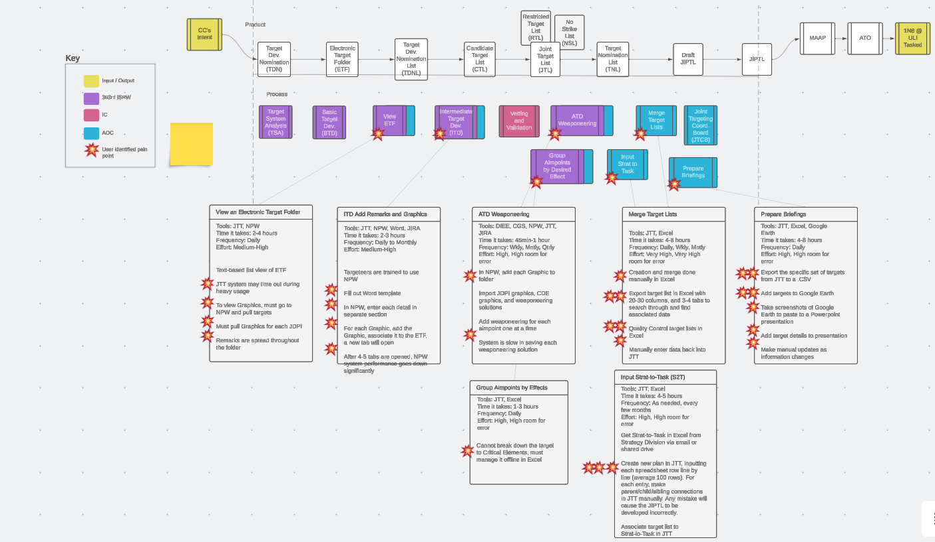
Target Planning

Slide 8
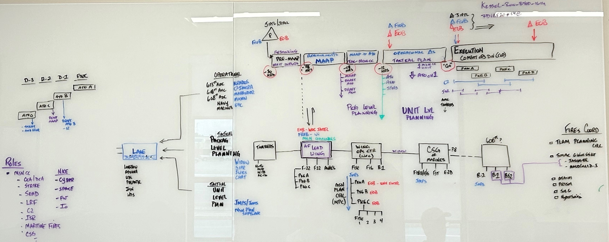
Unit Weapons Level Planning
Predictive & RT FrOB
Package COAs
Survivability analysis
Risk to Mission
Risk to Force
Auto MAAP Dynamic/ Sequenced
D-DIL ATO Plan
Timing/Tempo for Kinetic and nonkinetic
SPINS
Auto Package Planner
ISR: Auto sensor to requirements
Strike: Weapons COAs/Survivability
Airspace Deconfliction
Optimized Tanker Plan
NKE deconfliction
EW Recs
BDA Plan
IAMD Plan
Predictive & RT FrOB
Package COAs
Survivability analysis
Risk to Mission
Risk to Force
Auto Package Planner
ISR: Auto sensor to requirements
Strike: Weapons COAs/Survivability
Airspace Deconfliction
Optimized Tanker Plan
NKE deconfliction
EW Recs
BDA Plan
IAMD Plan

Slide 9
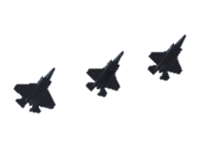
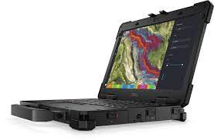
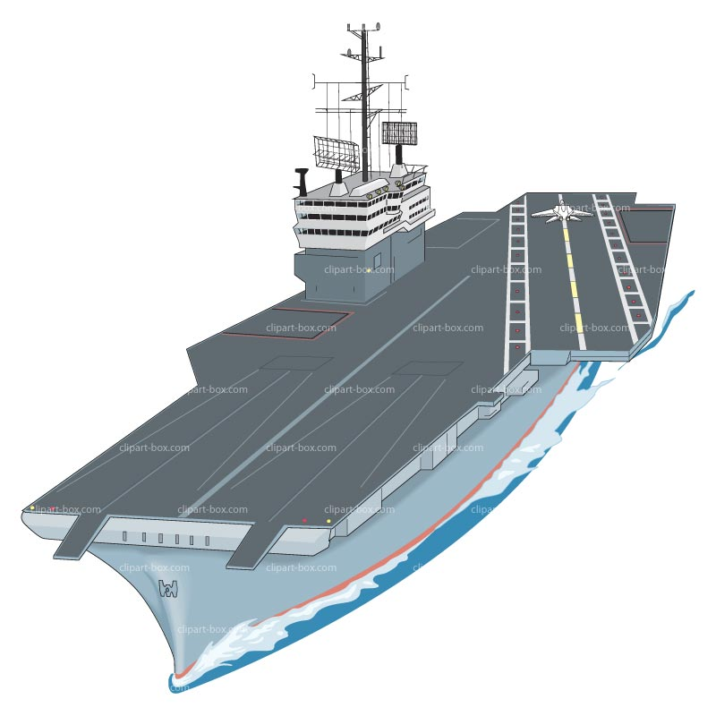

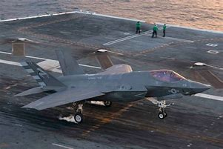
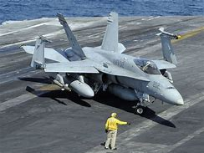
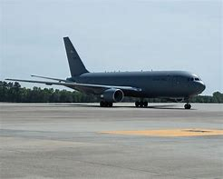
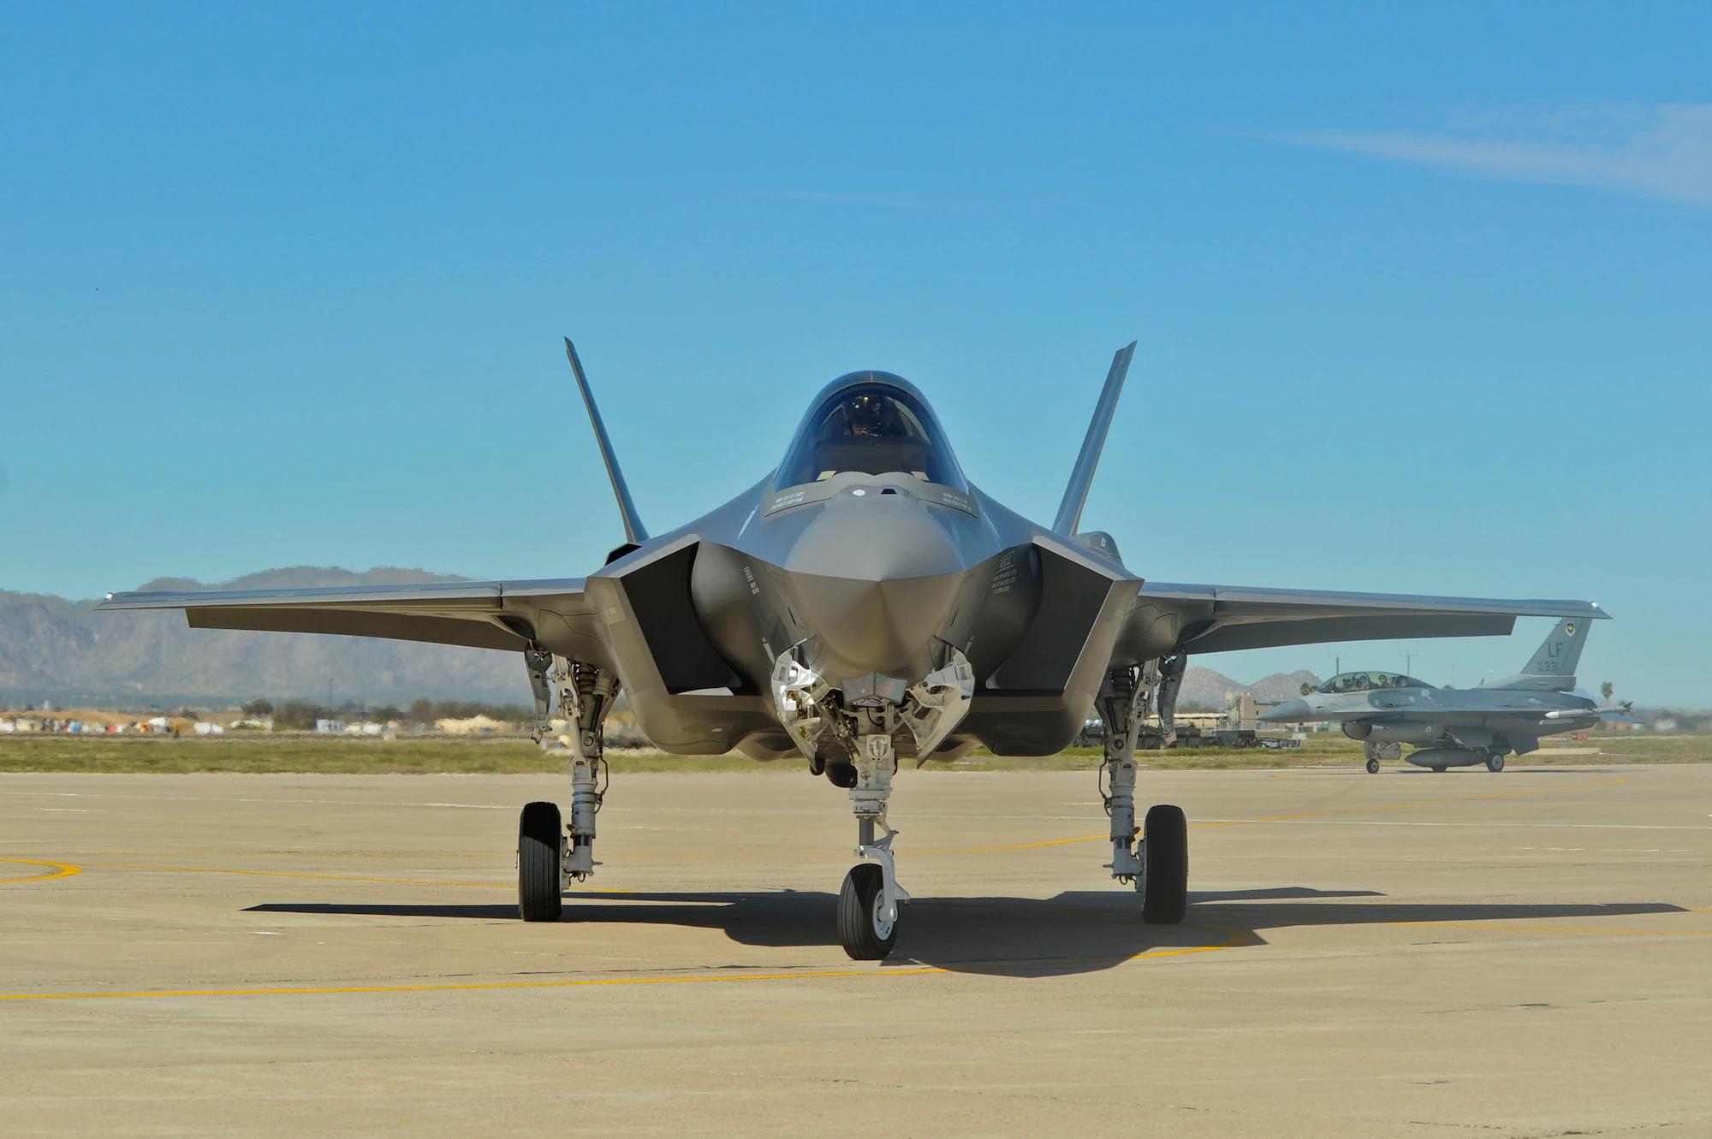
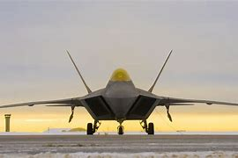

High Level Snapshot of Theater Air Planning - ”To-Be” Pre-decisional
TARGET
GAP, New, or TBD
ABMS/DDI BU
Edge Data Store
PLAN
FrOB
EOB
Plan Consumers
Operational
FrOB
613th AOC KRADOS X + Suite of Application (Cloud 1)
Integrated Msn Network
Coalition Partners
FrOB Data Sources:
Logistics – Fuels
Munitions
Airfield Status
Pkg Execution
Aircraft Mx / Avail
Personnel
FrOB Apps:
C2IMERA
MAI TAI
Jigsaw
Slapshot
Spacer
ATO
ACO
Spins
Opstasklink
Longbow
Advana
Theater Echelons
New Frob Data
Manager
Fight Tonight
C2CORE
JMPS
Envision?
Triton
EOB App
Nexus Suite of Apps
UDL
AMC ATOMS
AOC Multi-Tenancy
KRADOS X DATABASE BACKEND (CLOUD 1)
MAVEN
NEXUS Architecture
WDS
TOC-L
Airfield Status
608th AOC KRADOS X + Suite of Applications (Cloud 1)
618th AOC KRADOS X + Suite of Applications (Cloud 1)
CBC2
Data Schema /Clouds / Reachback (All TBD)
ABMS/DDI
ATO / ACO
Spins
AOD
Opstasklink
Target Tools (Nexus)
EOB App
Package Plan (Ex:)
Package Coord Card C2 Comm Plan
Timing / Tempo
NKE Requests
ISR Sync Matrix
Tanker Plan
Airspace Reqs
Divert Base
Pkg
AEW 1 / WOC
AEW 2 / WOC
WIDOW
C2IMERA
JMPS
Marauder
SOW Planning & Modeling Tools
JMPS
Widow
JMPS
Widow
COMREL
COMREL
C2IMERA
C2IMERA
SMAC
KRADOS?
KRADOS?
Marauder
PACKAGE LEVEL PLANNING
Marauder
WIDOW
JMPS / JOMS
Carrier Strike Group
WIDOW +. JMPS/JOMS
CANES
Air Apps
WIDOW +. JMPS/JOMS
WIDOW +. JMPS/JOMS
WIDOW +. JMPS/JOMS
UNIT LEVEL:
SCL
Fuel
Routing
Timing
Form Plan
Msn Data Load:
- Cryptos
- Flight Plan
- Wpns Data
- Comm /Freqs
- Datalink
WIDOW +. JMPS/JOMS
WIDOW +.
UNIT
Global Strike Mission Plan
AMC
Mission Plan
5th Gen WOC /
Sq MPC
Mission Plan
4th Gen WOC?
Sq MPC
Mission Plan
Coalition MPC
Mission Plan
JMPS
NOMS
Squadrons
Squadrons
Squadrons
Squadrons
Squadrons
JMPS (TS/SAR)
Air Apps (TBR)
Additional Unit Apps:
C2IMERA
Marauder
Voice/Chat Tools
Target Tools (Nexus)
EOB App
JMPS (S)
JMPS (TS/SAR)
JMPS (S/SAR)
Global Lightning
AMC ATOMS
JMPS (S/SAR)
Notes:
MPE Cloud CY23 DSOP Environments OV-1

Slide 10
Modernized AOC Architecture Pre-decisional
TARGET
GAP, New, or TBD
ABMS/DDI BU
Edge Data Store
PLAN
FrOB
EOB
Plan Consumers
FrOB
Coalition Partners
FrOB Data Sources:
Logistics – Fuels
Munitions
Airfield Status
Pkg Execution
Aircraft Mx / Avail
Personnel
Integrated Msn Network
FrOB Apps:
ATO
ACO
Spins
Opstasklink
C2IMERA
Longbow
Advana
Theater Echelons
New Frob Data
Manager
613th AOC KRADOS X + Suite of Application (Cloud 1)
UDL
AMC ATOMS
MAI TAI
Jigsaw
Slapshot
Spacer
WDS
Airfield Status
TOC-L
Fight Tonight
C2CORE
JMPS
Envision
Triton
EOB App
Nexus Suite of Apps
ATO / ACO
Spins
AOD
Opstasklink
Target Tools (Nexus)
EOB App
CBC2
NEXUS Architecture
KRADOS X DATABASE BACKEND (CLOUD 1)
MAVEN
ABMS/DDI
WIDOW
C2IMERA
JMPS
Marauder
Divert Base
Data Integration Layer (Cloud and On premises)
Package Plan (Ex:)
Package Coord Card C2 Comm Plan
Timing / Tempo
NKE Requests
ISR Sync Matrix
Tanker Plan
Airspace Reqs
AEW 2 / WOC
JMPS
WIDOW
JMPS / JOMS
Carrier Strike Group
WIDOW +. JMPS/JOMS
Widow
CANES
Air Apps
C2IMERA
JMPS (TS/SAR)
UNIT LEVEL:
SCL
Fuel
Routing
Timing
Form Plan
Msn Data Load:
- Cryptos
- Flight Plan
- Wpns Data
- Comm /Freqs
- Datalink
KRADOS
Additional Unit Apps:
C2IMERA
Marauder
Voice/Chat Tools
Target Tools (Nexus)
EOB App
TACTICAL PLANNING
Marauder
NOMS
JMPS
Notes:
MPE Cloud CY23 DSOP Environments OV-1

Slide 11



Decide
GAP, New, or TBD
ABMS/DDI BU
Edge Data Store
FrOB
SEE THINK DO
FrOB Data Sources:
Logistics – Fuels
Munitions
Airfield Status
Pkg Execution
Aircraft Mx / Avail
Personnel
ENABLE DECISION
MAKERS TO
MAKE SENSE
ACT
FrOB Apps:
LEAD WING EXECUTION
C2IMERA
Com Ops Pict (COP)
MAVEN SMART SYS
Diamond Shield
Lattice
BC-3
Communicate
RoIP
Chat Surfer
F2T2EA Tools:
JADOCS
TWB
HARDWARE
Mesh network
Local and theater wide
DDIL survivable
Software
Common apps
Shared info
New Frob Data
Manager
AUTOMATE
AUTOMATE
TOC and AEW
ABMS DDI
L-16, SADL, MADL
HF, RF
PACAF ROLE
613th AOC BASELINE
613th AOC NEEDED
AUTOMATE
Cyber Fast Track
PACAF Authorizing Official
Speed up infrastructure and
software delivery
Collaboration
COAC-X, ShOC-N & PACAF
Solutions must be Joint and Coalition
TBMCS
JOPES
KRADOS
C2CORE
TAK
MAAP-TK
CHAT SURFER
AROPS
Envision
JFN
JADOCS
EMAIL
MAVEN
ASSESS
Fight Tonight
STITCHES
EOB
DOF Turbo
Snapglass
MISSION EFFECTIVENESS
MISREP
Validate assumptions
Evaluate plan
RESTRIKE
Regroup, reissue
Shorten loop
EOB Data Sources:
CMCC
NIFE
DCGS
ISRD
SOCPAC
EOB Apps:
CIP
Thresher
GAIA
BOHDI
Build
Distro
Adapt
Operational
ATO / ACO
Spins
AOD
Opstasklink
Target
Enemy
Tactical
Package Coord Card C2 Comm Plan
Timing / Tempo
NKE Requests
ISR Sync Matrix
Tanker Plan
Airspace Reqs
LEARN
Improve tomorrow
Fully informed
Machine aided
PLAN
Data integration layer
Examples:
ABMS DI
Longbow
CDL / UDL
Transport
Examples:
MCHMR
Starlink
Hybrid Space Architecture

Slide 12
Common joint & coalition C2 collaboration tool in use
Theater wide secure, resilient, multi-path comms, especially from space
Real world weapon system integrated into joint data integration layer
1. Connect Data 2. Build workflows and models 3. Go faster (automate, optimize, orchestrate)
Integrate as a system of systems
Buy, rent or customize whatever commercial solutions exist
Protect intellectual property, minimize vender lock-in.
Joint and coalition shared TTPs agreed upon

Slide 13
Envision?
Airfield Status
Draft MAAP
Draft ATO/ACO
WIDOW
C2IMERA
JMPS
C2CORE
Three Days Prior
Two Days Prior
Day Prior
Execution Day
-72h
-66h
-60h
-54h
-48h
-42h
-36h
-30h
-24h
-18h
-12h
-06h
06h
12h
18h
24h
Planning FrOB
General Flow
Pre-MAAP
MAAP
ATO
Pkg Transit
Pkg Execution
Draft
MAAP
ATO DROP
A/C Taxi / Launch
A/C
Recovery
Different ATO Timelines
(Tankers / Bombers / Strike)
Airbase Consumers
FrOB Updates
Operational
Integrated Msn Network
Coalition Partners
FrOB Data Sources:
Logistics – Fuels
Munitions
Airfield Status
Aircraft Mx / Avail
Personnel
613th AOC KRADOS X (Cloud 1)
Longbow
Theater Echelons
FrOB Apps:
Jigsaw
Spacer
C2IMERA
MAI TAI
Slapshot
Triton
UDL
KRADOS X DATABASE
(CLOUD 1)
AMC ATOMS
New Frob Data
Manager
FrOB Schema (TBD)
WDS
618th AOC
608th AOC
Air Apps
Pkg
AEW / WOC
JMPS
Carrier Strike Group
AMC / Tankers
C2IMERA
C2IMERA
Fighter WOC
Sq MPC
C2IMERA
Widow
ABMS
DDI Kits
WIDOW
Bomber WOC
WIDOW
WIDOW
C2IMERA
UNIT
Squadrons
JMPS
Squadrons
JMPS
Squadrons
JMPS
KRADOS?
CBC2
TOC-L
New App / Data
NEW APP
NEW APP
AEW
- What data is needed to conducti predictive Frob
- Predictive Munitions
- Predictive Aircraft Availability (and pilots /)
- Systems Approach (Predictive Frob)
* Need set of contracts for data accuracy and management
** Need to train the force (TTPs)
*** Force People to train like Fight
Df -1
Df-2
Df-3
Df-4
Df-5
Df-6
Df-n
Df -1
Df-2
Df-3
Df-4
Df-5
Df-6
Df-n
ABAD
WIDOW
C2IMERA
JMPS
Divert
Possible FrOB Apps
WIDOW
JMPS

Slide 14
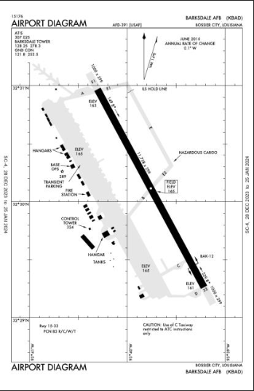
NEW APP
NEW APP
Three Days Prior
Two Days Prior
-72h
-66h
-60h
-54h
-48h
-42h
-36h
-30h
Day Prior
Example: Pkg “Day in a Life"
Execution Day (ATO AB)
-24h
-18h
-12h
-06h
06h
12h
18h
24h
MAAP
ATO
A/C Taxi / Launch
Pkg Transit
Pkg VUL PERIOD
A/C Recovery
Draft
MAAP
ATO DROP
Execution FrOB
General Flow
(3) CBC2 Reports
F-22 Minus 2; Min Package Not Met; Rolex 15 mins; Launch 2 xF-22 on alert Base Y
A/C Divert
C2IMERA
(1) WOC Updates:
20 Mins Late
#4 No MADL
(5) ATOMS Airfield Update
Base Z Closed Due to Attack; Tanker A and B Emer Fuel
(7) WOC Updates:
4 x F-35 Lands at Divert
Expect Turn Time 4 Hours
WIDOW
Airbase Consumers
FrOB Updates
JMPS
(2) WOC Updates:
Airbase X
Tanker X Msn Fallout
Launch alert Tanker Y
Coalition Partners
(6) TOC-L:
F-35s Tanker Fallout Proceed to Divert
Immediately Provides Airfield Status and recommends divert based on Airfield Status
Integrated Msn Network
Operational
(4) WOC Airbase Update
Base Z Closed Due to Attack;
613th AOC KRADOS X (Cloud 1)
Longbow/Advana
Theater Echelons
Jigsaw
Spacer
MAI TAI
Slapshot
Triton
ATO/ACO
Msn Updates
FrOB Schema (TBD)
UDL
**Each C2 Echelon and C2 “Node” Should be able to update Aircraft, Formation, Airbase Status For Real-Time Updates
AMC ATOMS
KRADOS X DATABASE
(CLOUD 1)
BLUE COP, Datalinks, Comms
WDS
Air Apps
Pkg
Carrier Strike Group
AMC / Tankers
C2IMERA
Bomber WOC
C2IMERA
Fighter WOC
Sq MPC
C2IMERA
ABMS
DDI Kits
Squadrons
WIDOW
WIDOW
WIDOW
1
CBC2
JMPS
Squadrons
JMPS
Squadrons
JMPS
NEW APP
Blue force tracking, Airbase Tracking, ATO Assigned Tasks – Will not be managed by one singular Ops C2 or Tac C2 Entity. They all need access to make updates to affect everyone ”down-stream”.
UNIT
TOC-L
618th AOC
608th AOC
AEW X
BLUE Force Accountability Tracker (CLOUD):
Mission Type
Aircraft Type / Tail Number Base Assigned
Number A/C in Acceptable Formations (1 of X)
SCLs – (SCL for each aircraft)
Pods / Capes (By Aircraft, not just formation)
MX Status (FMC/PMC/NMC)
System Status – Green or Fill-Ins
General Msn Flow: TO Location / Time
Msn Status – Ground / Air / Enroute / Execution / RTB / Divert
Air Refueling Location / Times / Assigned Tankers
C2 Capes / Freqs / Datalink
Net Enabled Wpns Data
RTB Location / Time
AEW
2
APP: PACKAGE TRACKER
Operational Objectives
Max Targets by Type
Phase / Day of War
Risk Level
Msn Type: DEAD, ISR, OCA, DCA
F2T2EA Capable?
Dedicated Support Rqd?
Adversary Assumptions
NKE Integration/Timing
Attack Axis/Anchor Locations
Attack Sequence, Timing, and Tempo
Package LIMFACS
ABAD
NEW APP
WIDOW
C2IMERA
JMPS
Divert
Wing/Unit/MC Package Planning & Execution
View/evaluate package details
Identify shortfalls
Propose alternatives
ID decision points &
Go/no-go implementation
Contracts
In-execution reflow based on updated recommendations
Wing/Unit/Mission Commander Package
Planning & Execution
Notes:
Execution FroB Requirements:
-Complexit of theater C2 presents several challenges with Blue Force Tracking
- Assets will not be managed or tracked by any one singular Ops C2 or Tac C2 Entity.
-- They all need access to make updates to affect everyone ”down-stream”.
- Creates two main requirement:
1. manage Blue Force Tracking for Safety of Flight, Awareness, Fuel Management, etc
2. manage Strike Package ALR, Force accountability, Min Force reqs, Fallout, timing and tempo, changes to C2 structure, etc
- This effort establishes TWO applications/software to help at every echelon across the joint force (THiNGS GET LOST IN CHAT
Other Reqs:
-6 and 3 hours prior to takeoff: computer scans missions numbers, assign aircraft to a package and FLAGS issues or changes in FrOB database
- Have computer scanning data and tagging potential problems and identifying FLAGS
1. Tanker Fallout – each receiver is flagged and someone has to turn that from Red to Green to ensure receiver knows information.
2. Airbase – Airbase goes from Green to Red
- Have FrOB (AI/ML) notifying ops floor or planners when aircraft is deviating from planned route; Flags if RTBs to different airbase and notifies planners of potential conflict for aircraft availability in planning cycle
- How do we get timing and tempo from TS/SCI/SAP players??
NEEDS:
Research all mission data that needs to be reported on across CAF, ISR, MAF, Etc
Research all pertinent package level data to include ALR, Guidance, Threat Level, Pkg ALR, Timelines, TOT, NKE, BDA for Success, etc

Slide 15
NEW APP
NEW APP
Three Days Prior
Two Days Prior
-72h
-66h
-60h
-54h
-48h
-42h
-36h
-30h
Day Prior
Example: Pkg “Day in a Life"
Execution Day (ATO AB)
-24h
-18h
-12h
-06h
06h
12h
18h
24h
MAAP
ATO
A/C Taxi / Launch
Pkg Transit
Pkg VUL PERIOD
A/C Recovery
Draft
MAAP
ATO DROP
Execution FrOB
General Flow
(3) CBC2 Reports
F-22 Minus 2; Min Package Not Met; Rolex 15 mins; Launch 2 xF-22 on alert Base Y
A/C Divert
C2IMERA
(1) WOC Updates:
20 Mins Late
#4 No MADL
(5) ATOMS Airfield Update
Base Z Closed Due to Attack; Tanker A and B Emer Fuel
(7) WOC Updates:
4 x F-35 Lands at Divert
Expect Turn Time 4 Hours
WIDOW
Airbase Consumers
FrOB Updates
JMPS
(2) WOC Updates:
Airbase X
Tanker X Msn Fallout
Launch alert Tanker Y
Coalition Partners
(6) TOC-L:
F-35s Tanker Fallout Proceed to Divert
Immediately Provides Airfield Status and recommends divert based on Airfield Status
Integrated Msn Network
Operational
(4) WOC Airbase Update
Base Z Closed Due to Attack;
613th AOC KRADOS X (Cloud 1)
Longbow/Advana
Theater Echelons
Jigsaw
Spacer
MAI TAI
Slapshot
Triton
ATO/ACO
Msn Updates
FrOB Schema (TBD)
UDL
**Each C2 Echelon and C2 “Node” Should be able to update Aircraft, Formation, Airbase Status For Real-Time Updates
AMC ATOMS
KRADOS X DATABASE
(CLOUD 1)
BLUE COP, Datalinks, Comms
WDS
Air Apps
Pkg
Carrier Strike Group
AMC / Tankers
C2IMERA
Bomber WOC
C2IMERA
Fighter WOC
Sq MPC
C2IMERA
ABMS
DDI Kits
Squadrons
WIDOW
WIDOW
WIDOW
1
CBC2
JMPS
Squadrons
JMPS
Squadrons
JMPS
NEW APP
Blue force tracking, Airbase Tracking, ATO Assigned Tasks – Will not be managed by one singular Ops C2 or Tac C2 Entity. They all need access to make updates to affect everyone ”down-stream”.
UNIT
TOC-L
618th AOC
608th AOC
AEW X
BLUE Force Accountability Tracker (CLOUD):
Mission Type
Aircraft Type / Tail Number Base Assigned
Number A/C in Acceptable Formations (1 of X)
SCLs – (SCL for each aircraft)
Pods / Capes (By Aircraft, not just formation)
MX Status (FMC/PMC/NMC)
System Status – Green or Fill-Ins
General Msn Flow: TO Location / Time
Msn Status – Ground / Air / Enroute / Execution / RTB / Divert
Air Refueling Location / Times / Assigned Tankers
C2 Capes / Freqs / Datalink
Net Enabled Wpns Data
RTB Location / Time
AEW
2
APP: PACKAGE TRACKER
Operational Objectives
Max Targets by Type
Phase / Day of War
Risk Level
Msn Type: DEAD, ISR, OCA, DCA
F2T2EA Capable?
Dedicated Support Rqd?
Adversary Assumptions
NKE Integration/Timing
Attack Axis/Anchor Locations
Attack Sequence, Timing, and Tempo
Package LIMFACS
ABAD
NEW APP
WIDOW
C2IMERA
JMPS
Divert
Notes:
Execution FroB Requirements:
-Complexit of theater C2 presents several challenges with Blue Force Tracking
- Assets will not be managed or tracked by any one singular Ops C2 or Tac C2 Entity.
-- They all need access to make updates to affect everyone ”down-stream”.
- Creates two main requirement:
1. manage Blue Force Tracking for Safety of Flight, Awareness, Fuel Management, etc
2. manage Strike Package ALR, Force accountability, Min Force reqs, Fallout, timing and tempo, changes to C2 structure, etc
- This effort establishes TWO applications/software to help at every echelon across the joint force (THiNGS GET LOST IN CHAT
Other Reqs:
-6 and 3 hours prior to takeoff: computer scans missions numbers, assign aircraft to a package and FLAGS issues or changes in FrOB database
- Have computer scanning data and tagging potential problems and identifying FLAGS
1. Tanker Fallout – each receiver is flagged and someone has to turn that from Red to Green to ensure receiver knows information.
2. Airbase – Airbase goes from Green to Red
- Have FrOB (AI/ML) notifying ops floor or planners when aircraft is deviating from planned route; Flags if RTBs to different airbase and notifies planners of potential conflict for aircraft availability in planning cycle
- How do we get timing and tempo from TS/SCI/SAP players??
NEEDS:
Research all mission data that needs to be reported on across CAF, ISR, MAF, Etc
Research all pertinent package level data to include ALR, Guidance, Threat Level, Pkg ALR, Timelines, TOT, NKE, BDA for Success, etc

Slide 16
App1- Global Unit FROB (User Form- Target User- Unit Commander)
Unit #/Desig
Type Aircraft
App3- Base FROB (User Form- Target Users- Airfield Manager, LRS, SFS, MXG)
App2- Unit Weapons FROB (User Form- Target User- Unit Weapons Officer)
Runway
Fuel Capacity by Type + Qty by Type
Taxiway
Ramp + Hydrant/Truck?
Type Aircraft
# PAA (Primary Aircraft Assigned)
Missions Assigned + Contingency Added
SCLs
Pods / Capabilities
Mission Type
# in Acceptable Formations
SCLs of each aircraft (multiple options for each aircraft per mission type ok)
Pods / Capes (multiple options for each aircraft per mission type ok)
Status: On Ground / In Air
Inflt Status: On Plan? (Y/N)
MX Status: On Ground / In Air (options for both)
On Ground: FMC/PMC/NMC
In Air: Status of all relevant systems (i.e., datalink, LR comms, As Fragged, SCL, Net Enabled Wpns, Changes in capes
Munitions Depots + Munitions Qty
# Fuel Trucks
IFR Capable
Security
Hot Pits / Pads / Arm/Dearm
Base/Rwy ICAO or Mil ID
Barriers
Authority
Msn Commander
SPINS
ACP
AADP
AOD
Category: Targets
Order of Battle: MIDB
Target Lists: JTT-CP
Method of delivery: Ripsaw
Current Target Location:
CMCC
DCGS API
Ops Report / Force Tell
External DIL
Potential for other 10.1 sources (unlikely)
JAOP
Guidance- Strat/Plan/Order (Complicated)
App3- Package Level Planning (User Form- Target Users- Integrations SMEs + MAAP Chiefs)
Risk Level
Msn Type: DEAD, ISR, OCA, DCA
F2T2EA Capable?
Dedicated Support Rqd?
Adversary Assumptions
NKE Integration/Timing
Operational Objectives
Attack Sequence, Timing, and Tempo
Attack Axis/Anchor Locations
Package LIMFACS
Max Targets by Type
Phase / Day of War
App 6- Plan Visualizer on Map + GANTT (App- Target Users- Same as App3)
Ingest Op Objective from AOD in priority order
ID Acceptable package for Op Objective in Priority Order:
Package timing / routing (JMPS/JOMS)
Package Gas needs (AROPS)
Account for LR Muns planning (SMAC)
Weaponeering
ROE (from SPINS)
ACA Limits (from ACP)
Approved Risk level (AOD)
Min Force Requirements
Fallout Options
Tanker
OCA/DCA
Strike
C2

Slide 17
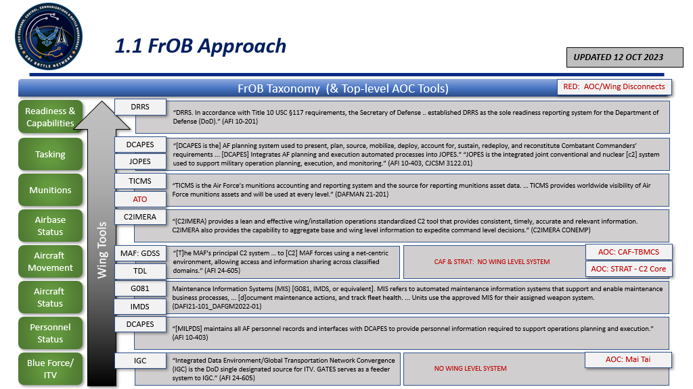
Function/sub-function example – JFACC FroB (Friendly order of Battle)
Notes:
This is the first swing at FrOB-related Apps, based on AFI guidance. More detailed analysis is underway.

Slide 18
frob – CNS Pairing + Additional value
CUI
CNS Section | HowGlobal FrOB Enables CNS Item:
2.1.1. “Continue improving AOC enterprise near real-time data is visible, persistently accessible and understandable to both support AOC operations and data sharing strategies.” | Ensures FrOB is from correct, authoritative source. Ensures FrOB is up to date in a M2M fashion.
2.1.2. “Implement initial releasability data tagging to enable FVEY coalition and partner access.” | Classification of some assets ingested natively from FrOB sources – rule set applied in KR DAL to prevent unauthorized disclosure.
2.2.3. “Produce Master Air Attack Plan (MAAP) in a timeline to support MTW conflict.” | Eliminate all manual actions related to FrOB. Eliminate all hand-jam errors associated with FrOB. Eliminate all meetings, personnel at AOC, phone calls, and AOC systems to support FrOB updates manually. Expedite process of FrOB ingestion into planning systems of record.
2.2.8. “Transition AOC systems from on prem to cloud to enable distributed C2 ensuring legacy capability remains that can operate at MTW scale.” | As we move to the cloud, enable distributed C2 – with less manpower at each distributed site – by ingesting authoritative FrOB data automatically.
2.2.9. “Improve FrOB accuracy and management within the system.” | Delivers exactly what is asked for.
2.4.1. “Research M2M interoperability with various authoritative data sources to reduce human error in FrOB development and management.” | Research nearly complete. M2M interoperability across FrOB is doable today with connection to external DIL / Data Lake. Eliminates human error.
2.4.4. “Enable initial data interoperability between Geographic AOCs weapon system data and Functional AOCs (608th and 618th AOC) | FrOB data between 608/618 now fully synchronized inclusive of Goldwater-Nichols Act & Title 10 USC COMREL considerations & SECDEF orders that transfer it.
2.9.1. “Simplify the dynamic targeting coordination process.” | Immediate knowledge of FrOB status – on ground, on alert, after launch – all the way to the target. DT coord process reduced to single click alert across multiple bases globally.
Global FrOB can be provided in United States Message Text Format (USMTF) National Information Exchange Model (NIEM) data standards
Knowledge of global FrOB critical for DDIL ops – reduces errors, increases situational awareness during most critical combat scenarios
Global FrOB critical to scaling to MTW level capability – especially in distributed operations
Addressing FrOB is critical to draft 2024 CNS (as of Aug 2023) – and delivers key value to warfighters
CUI

Slide 19
